Slide 1

ML FACULTY REVIEW · PROJECT 2026
Reproducing & Extending Price-Bin Prediction for Funko Pop Collectibles
UE24CS352A — Machine Learning · Semester 5K
Rosalin Verma · PES2UG24CS655
Keerthana M · PES2UG24CS638
October 4, 2026

Slide 2

01 · PROBLEM & MOTIVATION
Predicting resale value in a skewed collectibles market
Challenge
Predict price bins for limited-edition Funko Pop collectibles where secondary-market prices are highly skewed.
Why it matters
Resale prices vary widely, making exact price prediction difficult with limited transaction data.
Key framing
Formulated as a 5-class classification problem using log-scale price bins.
UE24CS352A · ML Faculty Review · 2/14

Slide 3
02 · DATASET & FEATURES
StockX secondary market, 359 filtered items
FEATURE
DESCRIPTION
359
Category
Franchise / character category
items after filtering
Material
Vinyl type and finish
59
Special_version
product edition / special-version category
+ 4 ordinal features for custom kernel
Search volume is an external popularity signal, log-transformed before scaling.
Search volume
Public interest proxy (external)
UE24CS352A · ML Faculty Review · 3/14

Slide 4
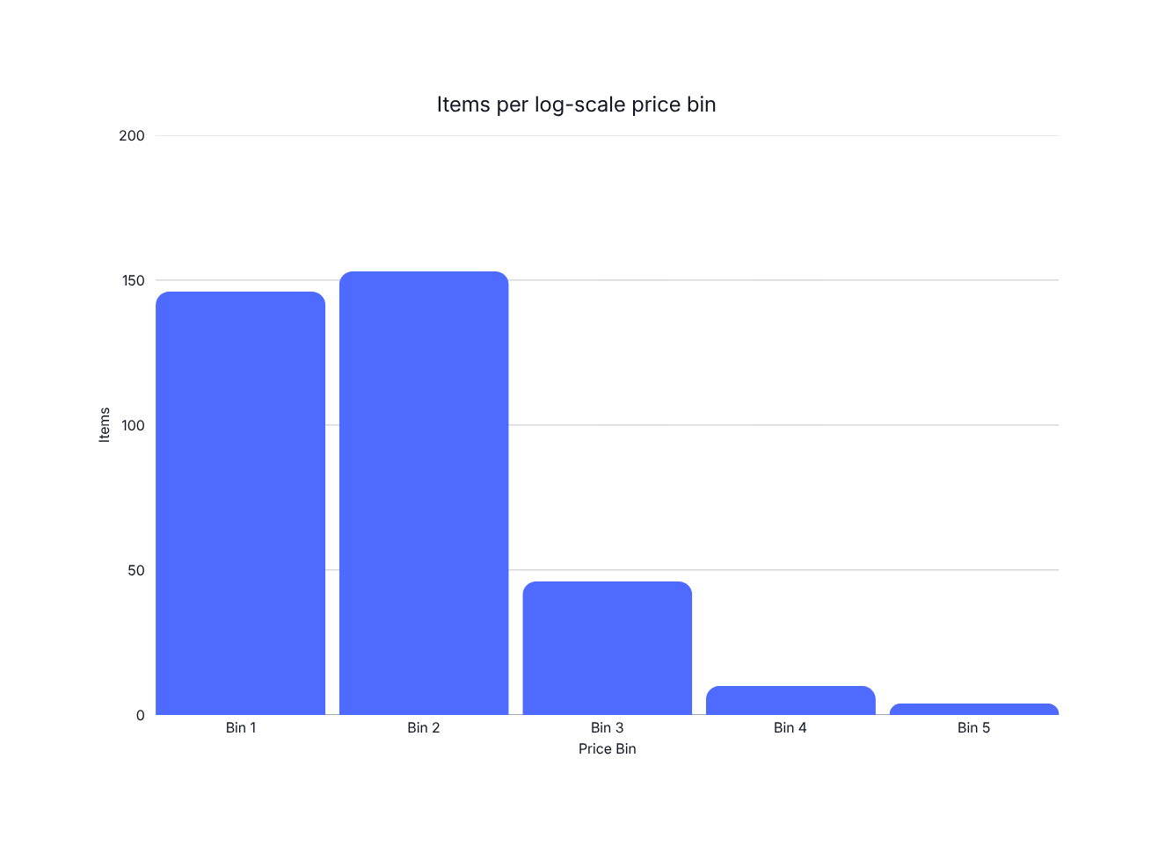
03 · TARGET VARIABLE
Five logarithmic price bins — severe class imbalance
The imbalance problem
Bins 1–2 dominate with 299 items. Bins 4–5 contain only 14 samples combined, making reliable learning and evaluation difficult.
83%
of all samples are in Bins 1 & 2
No model successfully learned Bin 5
UE24CS352A · ML Faculty Review · 4/14

Slide 5
04 · PREPROCESSING & VALIDATION
Consistent folds, two encodings for two model families
Raw data
Transform
Encode
Stratified 4-fold CV
Model training
StockX · 359 items
log(search_vol) + Min-Max
One-hot (59) · Ordinal (4)
shuffle=True · seed=1
6 models · shared folds
ONE-HOT · 59 features
→ Linear SVM, RBF SVM, Trees, Bagged, XGBoost
ORDINAL · 4 features
→ Custom kernel SVM
UE24CS352A · ML Faculty Review · 5/14

Slide 6
05 · OVERALL PIPELINE
From raw sales to F1-scored predictions
1
2
3
4
5
6
Ingest
Preprocess
Encode
Train
Validate
Evaluate
StockX feed
log + scale
OHE / Ordinal
6 models
Stratified CV
P / R / F1
UE24CS352A · ML Faculty Review · 6/14

Slide 7
06 · BASELINE MODELS
Linear SVM vs RBF SVM
Linear SVM
RBF SVM
· One-vs-One multiclass
· Nonlinear kernel
· Linear decision boundary
· Tested for lift over linear
· Baseline reference
· Did not outperform baseline
· Val F1 = 0.440
· Val F1 = 0.438
UE24CS352A · ML Faculty Review · 7/14

Slide 8
07 · CUSTOM KERNEL SVM
Weighted similarity across heterogeneous features
Category
w = 2
Kernel structure
K(x, x′) = Σ wᵢ · kᵢ(xᵢ, xᵢ′)
Material
w = 1
Each feature type contributes its own similarity kernel. Weights [2, 1, 1, 3] incorporate domain knowledge, giving different feature types different importance.
Special_version
w = 1
ORDINAL encoding · 4 features
Val F1 = 0.423
Search volume
w = 3
UE24CS352A · ML Faculty Review · 8/14

Slide 9
08 · TREE-BASED MODELS
A single tree overfits; bagging stabilises
Decision Tree
Bagged Decision Tree
Non-parametric. Overfits small, imbalanced data.
Ensemble of 100 trees · bootstrap aggregation.
TRAIN F1
VAL F1
TRAIN F1
VAL F1
0.983
0.409
0.983
0.456
Train–Val gap = 0.574 · classic overfit
Highest validation F1 among the reference models
UE24CS352A · ML Faculty Review · 9/14

Slide 10
09 · PROJECT EXTENSION
XGBoost — gradient boosting over sequential trees
Tree 1
+ Residuals
Tree 2
+ Residuals
Tree n
Prediction
Default
Shallow
Class-balanced
n=100, lr=0.3
max_depth=3
sample_weight
Val F1 0.452
Val F1 0.454
Did not improve validation F1
UE24CS352A · ML Faculty Review · 10/14

Slide 11
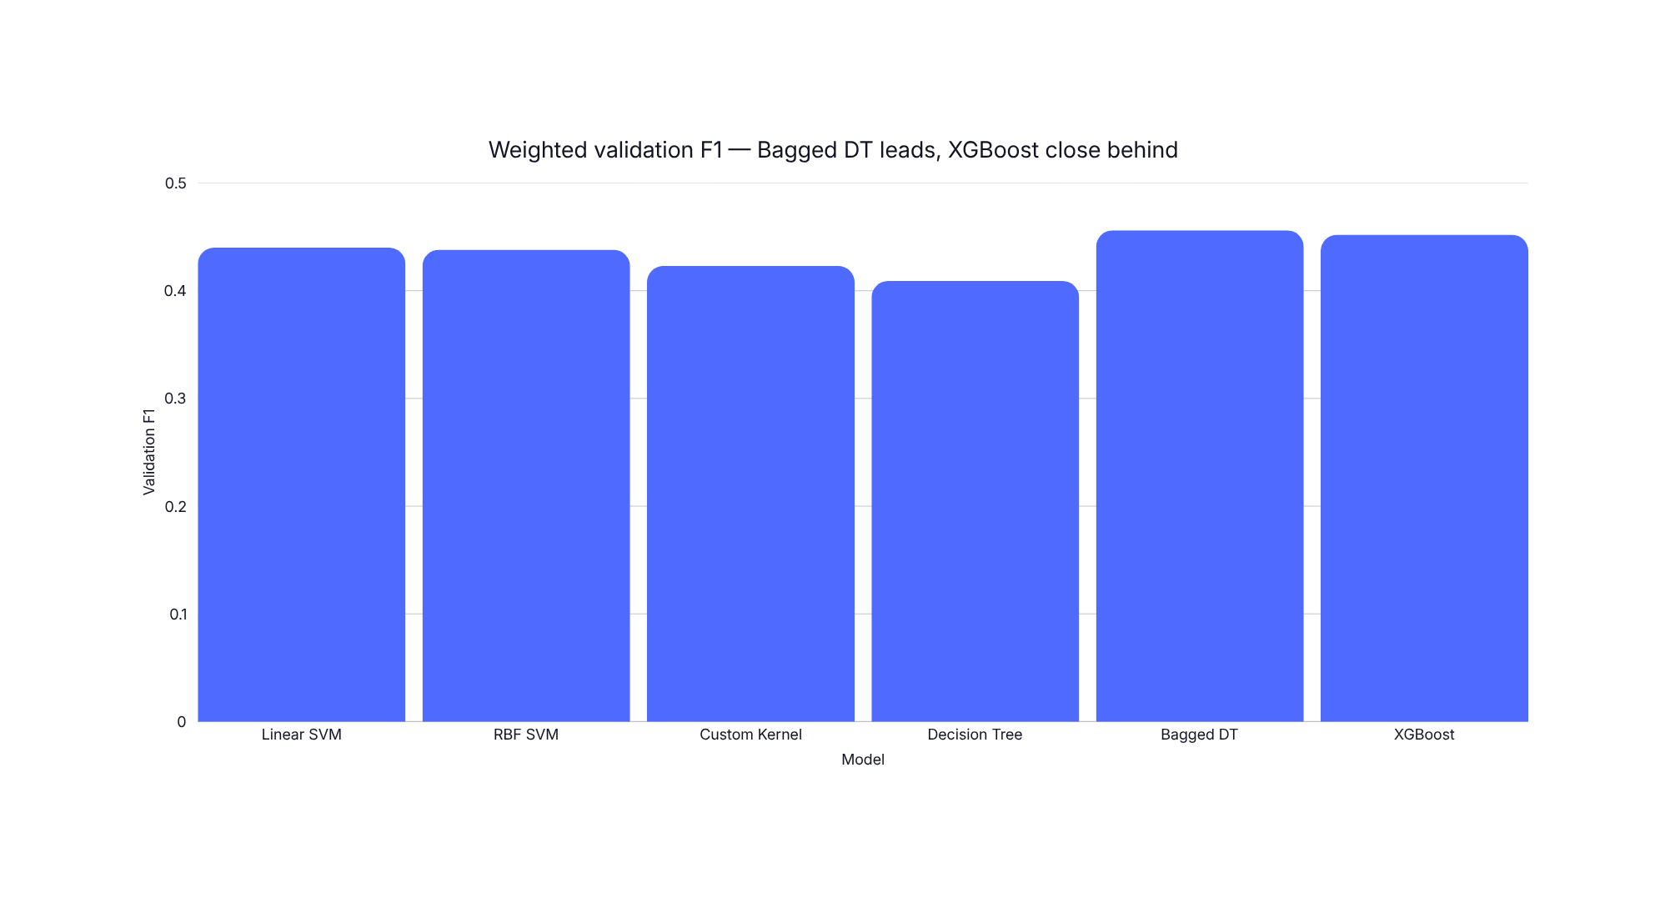
10 · MODEL COMPARISON
Validation F1 across all six models
UE24CS352A · ML Faculty Review · 11/14

Slide 12
11 · KEY FINDINGS
What the numbers actually tell us
WINNER
RUNNER-UP
INSIGHT
Bagged DT leads
XGBoost competitive
RBF ≈ Linear
0.456 validation F1 — bagging smooths out single-tree variance.
0.452 F1, but train F1 = 0.962 signals overfitting.
No lift from nonlinear kernel on this feature space.
RISK
LIMIT
ROOT CAUSE
Overfit single tree
Bin 5 unlearnable
Data limitation
Train 0.983 → Val 0.409: classic high-variance failure.
Only 4 samples — no model predicts the rarest bin.
Severe imbalance and small N cap achievable F1.
UE24CS352A · ML Faculty Review · 12/14

Slide 13
12 · CONCLUSION & FUTURE WORK
Reproduced, extended, and a clear path forward
Conclusion
Future work
Reproduced the reference models with comparable validation results.
Collect more data, especially for rare price bins
Enrich features with fan-forum text and release date
Extended with XGBoost — competitive at 0.452 F1.
Address class imbalance using SMOTE / cost-sensitive learning
Observed substantial train–validation gaps in tree-based models.
Documented class-imbalance ceiling honestly.
UE24CS352A · ML Faculty Review · 13/14

Slide 14

FINAL · 14 OF 14
Live Demo & Q&A
Predicting price bins with our trained models — then your questions.
Rosalin Verma · Keerthana M
Thank you.

